Slide 1
An evaluation of COE’s for Gastroenterology Procedures

Slide 2
Contents
Executive Summary
Questions
Background
Cost compared to market
Cost variability
Affordable provider offerings
Appendix (Excel)

Slide 3
Executive Summary
To design better gastro products, Mt. Sinai Hospital Systems (MSHS) would need to:
Revise their current provider rates who are offering therapeutic colonoscopies to be more competitive in the market.
Steer members to cheaper settings (Office or Ambulatory Surgical Centers) using value arrangements and other methods would make MSHS more economical in any colonoscopy type.
Anesthesiology costs were one of the drivers of episode costs in MSHS. Methods such as employing anesthesiologist when clinically warranted would help in controlling costs in certain settings.
More data would be needed to understand how bundled payments impact the value of health care delivered.
For example an “Office” setting may offer the value of improving patient outcomes and reducing the incidence of complications when compared to other settings.
Member steerage should take health outcomes and general service satisfaction into account.

Slide 4
Questions
Mt. Sinai’s sales team was approached by a large employer group, interested in a COE for gastroenterology procedures. The client's health plan (payer) provided Mt. Sinai with episodic data to assess the opportunity within colonoscopy procedures. The analysis presented will address three questions:
What is Mount Sinai’s cost relative to the market?
What drives variability in episode cost?
Are there Mount Sinai providers that should be included in the program to create an affordable offering?

Slide 5
Background
The colonoscopies provided in the episodic data were diagnostic or therapeutic and were performed in three major care settings: Office, Ambulatory Surgery Center, and Outpatient. Designating a colonoscopy as “diagnostic” versus “therapeutic” is usually done after the procedure is performed¹. However, the episodic data has separated the two.
Diagnostic Colonoscopy¹ A diagnostic colonoscopy allows the physician to visualize the colon for any abnormalities or to establish a diagnosis. The patient may exhibit symptoms such as diarrhea, blood in stool, abdominal pain, etc. Risk factors also play an important role in diagnosis coding.
Therapeutic Colonoscopy¹ Therapeutic colonoscopy occurs when abnormalities (often found during a screening) are treated. During therapeutic procedures, lesion or polyps maybe removed for biopsy via polypectomy, laser removal, or cauterization.
1. Reference: https://www.aapc.com/blog/24311-consider-all-factors-when-coding-colonoscopies/

Slide 6
Question 1: What is Mount Sinai’s cost relative to the market?
Diagnostic
Therapeutic
Notes:
Key Point for Diagnostic
Office makes up a significant proportion of diagnostic colonoscopies and tend to be cheaper
Amb Surg Centers cost are between Office and Outpatient
Outpatient cost have large variability thus the spread of data and outliers in blue are evident.
Key Point for Therapeutic
Amb Surg and Office make up most of the therapeutic colonoscopies regardless of cohort
Outpatient costs are the most expensive

Slide 7
Question 1: What is Mount Sinai’s cost relative to the market?
To understand Mt.Sinai’s cost in comparison to the market for therapeutic and diagnostics colonoscopies, we will look at visualizations and summary statistics of episode and other related costs in their respective settings.
All Colonoscopies
N=1322 | μ ± σ
($2508 ± $1483)
Diagnostic
N=428 | μ ± σ
($1944 ± $1337)
Non-MSHS
N=399 | μ ± σ ($1843 ± $1223)
MSHS
N=29 | μ ± σ ($3341 ± $1954)
Therapeutic N=894 | μ ± σ
($2778 ± $1474)
Non-MSHS
N= 810 | μ ± σ ($2566 ± $1195)
MSHS
N= 84 | μ ± σ ($4828 ± $ 2184)
Notes:
Mount Sinai’s cost in comparison to non-MSHS can be explained by three cost categories (gastro, anesthesiology, and facility) which when totaled make up the episode amount. Upon initial examination of the data, we see that colonoscopies can be performed in three settings (Ambulatory Surgery Center, Hospital Outpatient, and Office) for two different purposes (therapeutic and diagnostic).
Key Points:
Large variability (σ) in cost due to combination of different settings
MSHS is more expensive in both therapeutic and diagnostic colonoscopies before breaking it down by settings

Slide 8
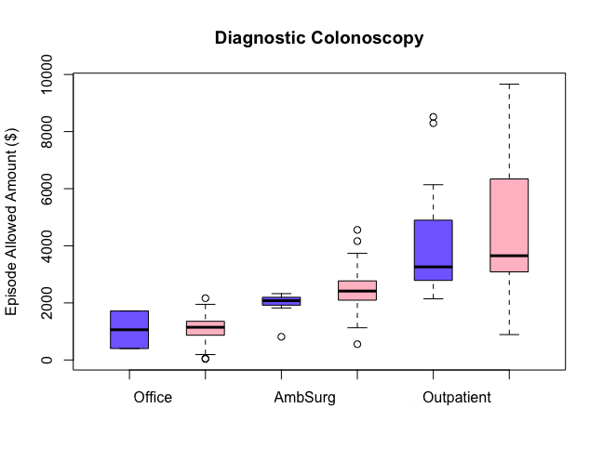
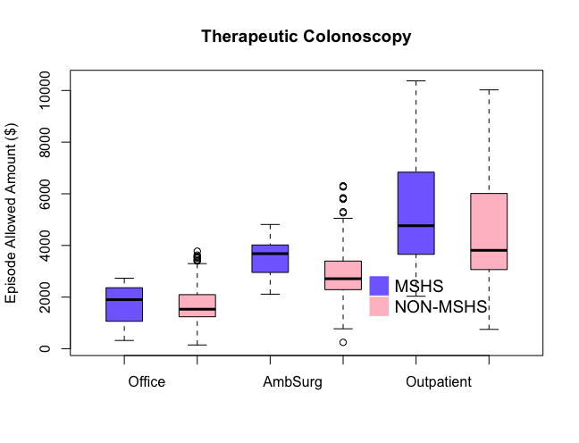
Question 1: What is Mount Sinai’s cost relative to the market?
Notes:
Key Points for Diagnostic
For MSHS the sample size for diagnostic colonoscopies are rather small and the variability based on the standard deviations are similar to that of NonMSHS (tab- ‘episode smry’). The mean and median episode costs for MSHS are less than NonMSHS. The episode costs on average for diagnostic colonoscopies are cheaper with MSHS.
We can look at provider and facility combinations that are below or at the mean cost for diagnostic to understand which facility or providers are ‘cost efficient’
Facility 28, 29, and 3 were on average more expensive than other facilities (Amb Surg)
Facility 17 and 18 were on average more expensive that other facilities (Hosp Outpatient).
Key Points for Therapeutic
We can conclude that MSHS is on average more expensive than Non-MSHS. Regardless of the setting in therapeutic or diagnostic colonoscopies, the anesthesiology cost for MSHS on average has been more expensive than Non-MSHS
Similarly we can look at cost for therapeutic in different facilities and providers within their respective settings to determine their cost efficiency
Facility 3 was considerably more expensive than other amb surg centers which administer therapeutic colonoscopies
Facility 17 and 18 were significantly more expensive

Slide 9
Question 1: What is Mount Sinai’s cost relative to the market?
Understanding which MSHS facilities are less than μ + 1σ for episode, facility, and anesthesiology costs.
One provider can practice at multiple facilities (example: pid: 27 @ facilites: 17 and 18). Comparing the episode and provider costs of physicians who are practicing at multiple facilities
The actual episode may vary on the procedure complexity or units.
Based on the summary statistics, Ambulatory surgery centers and Offices are economical regardless of colonoscopy type.
MSHS and Non-MSHS providers practice at the same facilities (example pid 15)

Slide 10
Question 2: What drives variability in episode cost?
To understand the factors associated with episode cost, I used a general linear model which modeled the capitated episode cost.
I first capped the episode allowed amount by colonoscopy type and setting using a percentile approach for the upper limit and standard deviation approach for the lower bound. Percentile plots and μ ± σ understood from the plots.
In both types of colonoscopies, the independent variables modeled were: quarter, gastro physician category, and setting.
Facilities and providers were not included in the model due to multiple comparison between groups. Moreover, we can understand differences in cost by looking at the summary statistics by providers.

Slide 11
Question 2: What drives variability in episode cost?
Diagnostic
Source | DF | Sum of Squares | Mean Square | F Value | Pr > F
Model | 8 | 475840340.4 | 59480042.6 | 102.54 | <.0001
Error | 416 | 241296288.1 | 580039.2
Corrected Total | 424 | 717136628.5
R-Square | Coeff Var | Root MSE | Mean Episode Amount (Cap)
0.663528 | 39.21175 | 761.603 | $1,942.28
Source | DF | Type III SS | Mean Square | F Value | Pr > F
quarter | 5 | 7180456.9 | 1436091.4 | 2.48 | 0.0316
gastrophysician_cate | 1 | 3374293.7 | 3374293.7 | 5.82 | 0.0163
setting | 2 | 410809337.4 | 205404668.7 | 354.12 | <.0001
Parameter | Estimate | Standard Error | T Value | Pr > |t|
Intercept | 897.85 | 119.86 | 7.49 | <.0001
quarter 15Q2 | 383.29 | 139.74 | 2.74 | 0.0064
quarter 15Q3 | 22.44 | 149.96 | 0.15 | 0.8811
quarter 15Q4 | 258.64 | 143.53 | 1.8 | 0.0723
quarter 16Q1 | 239.71 | 142.01 | 1.69 | 0.0922
quarter 16Q2 | 144.66 | 141.58 | 1.02 | 0.3075
quarter 15Q1 | 0.00 | . | . | .
gastrophysician_cate MSHS | -406.74 | 168.64 | -2.41 | 0.0163
gastrophysician_cate NonMSHS | 0.00 | . | . | .
setting Amb. Surg. Center | 1365.14 | 80.71 | 16.91 | <.0001
setting Hosp. Outpatient | 3495.06 | 143.23 | 24.4 | <.0001
setting Office | 0.00 | . | . | .
Notes:
The model is statistically significant and the R-squared value of 0.66 would indicate a good fit. One of the reasons we did not include other related costs was due to the fact that they were associated with episode costs.
When we examine the statistically significant parameter estimates (<0.05):
1. Quarter 15Q2: there is $383 difference when compared to the reference of 15Q1. 2. Being in MSHS is $407 cheaper than Non-MSHS. 3. Ambulatory was $1364 more expensive than the office setting 4. Hospital outpatient setting was $3495 more expensive than the office setting

Slide 12
Question 2: What drives variability in episode cost?
Therapeutic
Source | DF | Sum of Squares | Mean Square | F Value | Pr > F
Model | 8 | 927379537 | 115922442 | 110.35 | <.0001
Error | 883 | 927585373 | 1050493
Corrected Total | 891 | 1854964911
R-Square | Coeff Var | Root MSE | Mean Episode Amount (Cap)
0.499945 | 37.03267 | 1024.936 | 2767.653
Source | DF | Type III SS | Mean Square | F Value | Pr > F
quarter | 5 | 17669536.4 | 3533907.3 | 3.36 | 0.0051
gastrophysician_cate | 1 | 26670050 | 26670050 | 25.39 | <.0001
setting | 2 | 515704640.6 | 257852320.3 | 245.46 | <.0001
Parameter | Estimate | Standard Error | t Value | Pr > |t|
Intercept | 1509.85 | 107.90 | 13.99 | <.0001
quarter 15Q2 | -48.62 | 126.12 | -0.39 | 0.6999
quarter 15Q3 | 139.64 | 129.85 | 1.08 | 0.2825
quarter 15Q4 | 338.89 | 127.86 | 2.65 | 0.0082
quarter 16Q1 | 236.37 | 124.87 | 1.89 | 0.0587
quarter 16Q2 | 273.75 | 125.93 | 2.17 | 0.03
quarter 15Q1 | 0.00 | . | . | .
gastrophysician_cate MSHS | 746.18 | 148.09 | 5.04 | <.0001
gastrophysician_cate NonMSHS | 0.00 | . | . | .
setting Amb. Surg. Center | 1198.53 | 76.69 | 15.63 | <.0001
setting Hosp. Outpatient | 2818.22 | 138.29 | 20.38 | <.0001
setting Office | 0.00 | . | . | .
Notes:
The model for therapeutic colonoscopies was also statically significant with R squared value of 0.499.
When we examine the statistically significant parameter estimates (<0.05) for the model above:
MSHS was $746 more expensive than Non-MSHS
Being in a Hospital Outpatient setting was $2818 more expensive than being in an office setting.
Being in ambulatory surgical center was 1198 more expensive than being in an office setting.
Q116 and Q216 were significantly more expensive than the reference quarter of Q115.
The episode costs seem to be decreasing from Q415 to Q216 when compared to their reference (15Q1).

Slide 13
Question 2: What drives variability in episode cost?
MSHS would need to revise pricing in order to lower costs and make a more economically attractive offer to their plan sponsors or patients. If MSHS had the support of their payers and plan sponsors, creating a narrow network to steer more customers to an office setting which is considerably cheaper than an ambulatory or hospital outpatient setting would be optimal.
Suggestion: More research and data is needed to push members to an office setting. It is unclear whether an office or ambulatory setting has better health outcomes.
Understanding value arrangements between payers and providers (facility and physician) would need more clarity.

Slide 14
Q3: Are there Mount Sinai providers that should be included in the program to create an affordable offering?
MSHS representation in the sample was small and the approach to solve this problem could have been done in two ways.
The first method would look at the quartiles and deciles of cost for the providers. This would allow us to choose a suitable cost range based on these deciles and where MSHS providers should be when compared to their Non-MSHS counterparts. Within the first method you’d want to validate this by overlapping the mean and standard deviation with the deciles.
The second approach used was cluster analysis of mean episode cost by providers which was further segmented by their procedural setting and colonoscopy type. We used the second approach for diagnostic and therapeutics.

Slide 15
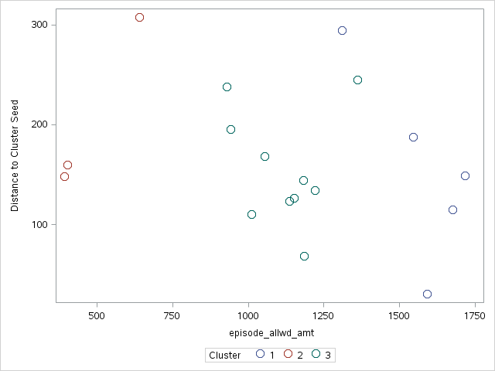
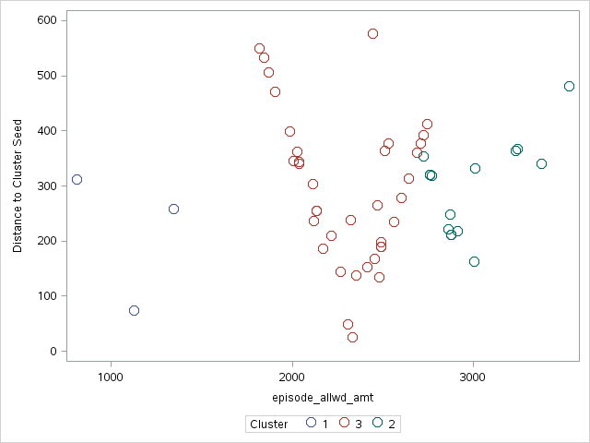
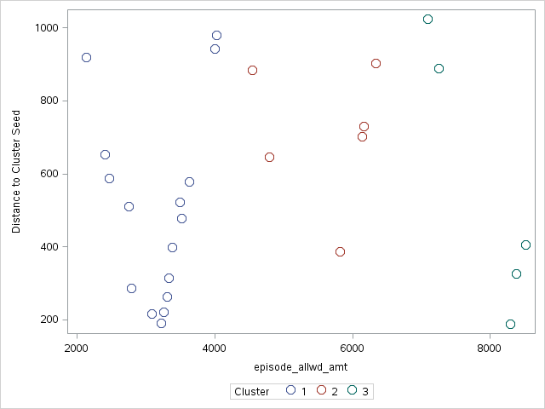
Q3: Are there Mount Sinai providers that should be included in the program to create an affordable offering?
Diagnostic | Office
Diagnostic | Amb Surg
Diagnostic | OP
Notes:
Diagnostic colonoscopies: Please refer to the appendix for cluster analysis results.
For MSHS providers who were performing below or around the average cost:
clusters 1 (Amb Surg Center only)
clusters 2 (Amb Surg Center and Hosp. Outpatient)
clusters 3 (Office only).
For a list of providers in the aforementioned clusters, please refer to the ‘diagnostic providers’ tab.
Note that the clusters 1-3 were performed for their individual setting and not together. I selected three clusters for each setting and therefore cluster 2 in Amb Surg and Office have no relation except for a lable.

Slide 16
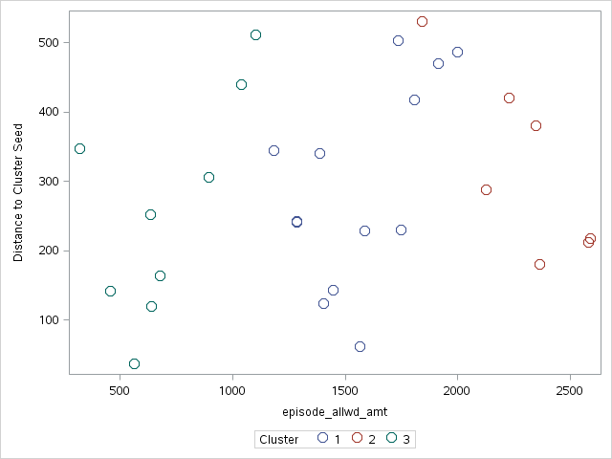
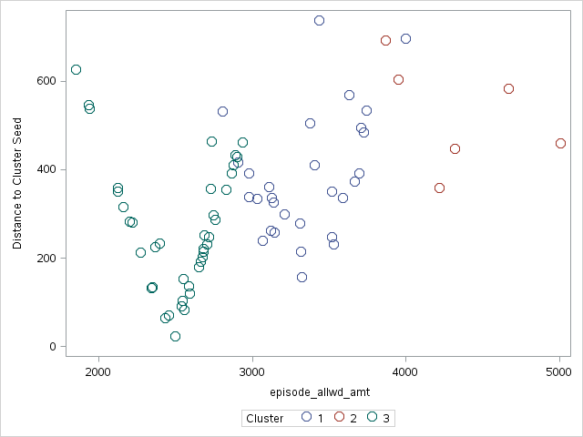
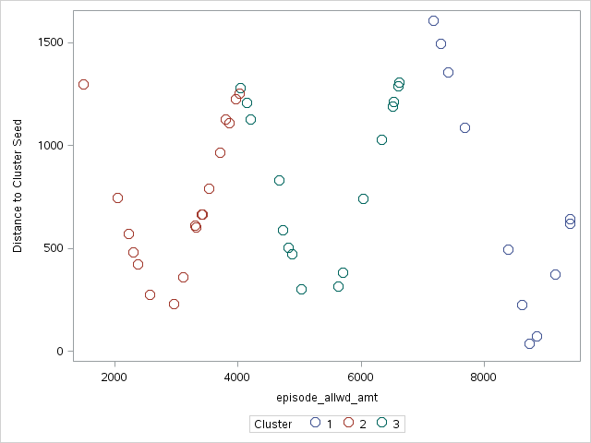
Q3: Are there Mount Sinai providers that should be included in the program to create an affordable offering?
Therapeutic | Office
Therapeutic | Amb Surg
Therapeutic | OP
Notes:
Therapeutic colonoscopies:
I would request that you review the q3 therapeutic cluster tab in the output.
For MSHS providers to include therapeutic colonoscopies:
-cluster 2 (Amb Surg Center and Office)
-cluster 3 (Amb Surg Center and Hospital Outpatient Center).
For a list of providers in the aforementioned clusters, please refer to the ‘therapeutic providers’ tab.
Note that the clusters 1-3 were performed for their individual setting and not together. I selected three clusters for each setting and therefore cluster 2 in Amb Surg and Office have no relation except for a label.

